Slide 1
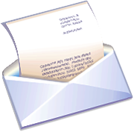
Letters

Slide 2
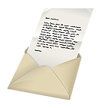
Reflect.
Think back to the last letter you wrote. (The letter to me doesn’t count!)
How old were you?
Who did you write to?
What did you write about or why were you writing?
Did you receive a letter back?

Slide 3
Letters
Think of all the types of letters you have received or written. List them on our notes.
Examples: love letters, letter to a teacher, letters to a friend (notes), letters to offer or solicit advice, parent letters from school, letters to the editor

Slide 4
What is the purpose of a letter?
To inform
  What might people write about in an informational letter?
To persuade
  What might people write about in a persuasive letter?
What other purposes can you think of?

Slide 5
Key Terms
Heading
  Your address
Recipient/Receiver
  who you are sending it to
Inside address
  The address of the recipient
Salutation
  greeting
Signature
  your signed name

Slide 6
Different Formats
Business letter
Friendly letter
Cover letter
Letter to the editor
Dear Abby letter (advice)

Slide 7
Keys to a good letter
The letter is written in the correct format for the purpose and audience.
The letter’s purpose is clear, as stated in an introductory paragraph which is supported by details/facts sufficient enough to clearly persuade or inform the reader of the writer’s intent.
The writer uses appropriate vocabulary, tone and style that reflects knowledge of the intended audience.
The writing demonstrates control of grammar, paragraph and sentence structure and shows accurate spelling and correct use of punctuation and capitalization.
The letter has clearly been proofread and revised to improve word choice, organization and consistency.

